Slide 1
State by View
File created on: 6/17/2019 9:54:43 AM

Slide 2
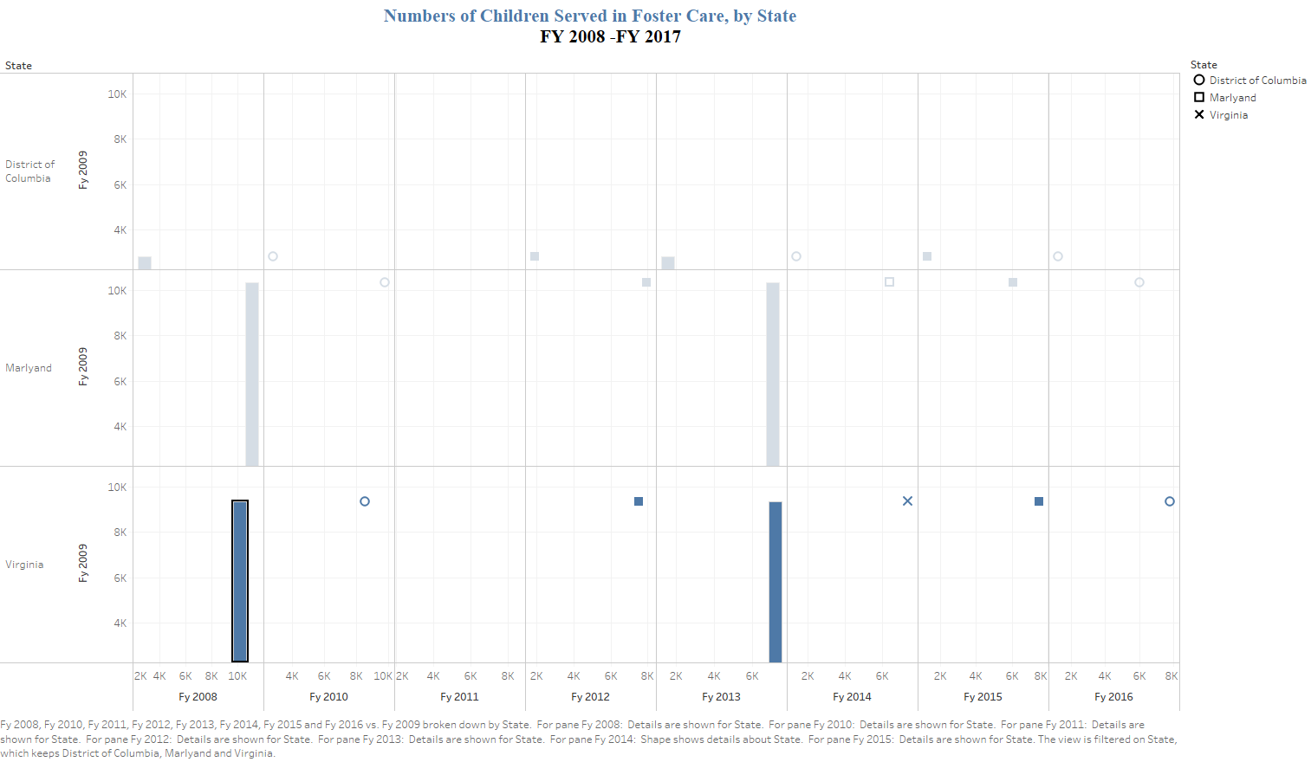

Slide 3
